Slide 1
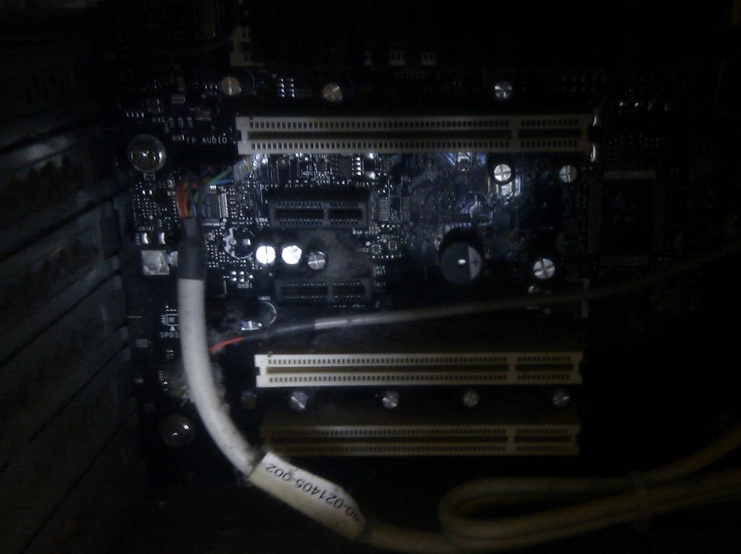

Computing Systems
Lecture 3
Binary Representation
& Boolean Logic

Slide 2
Zeroes and Ones (Again, again)
Introduced binary representation
  How a single transistor can form a simple electronic switch (one bit)
  How binary can be used to represent numbers and symbols
Now to build on that...
  Representing negative and real numbers
  More complex logical operations
  How computers add numbers

Slide 3
Logic
Logic circuits are the building blocks of computers
Boolean values are True/False values – equivalent to the On/Off or 1/0 values of binary
Boolean operations take some number true/false inputs, and give a true/false output

Slide 4
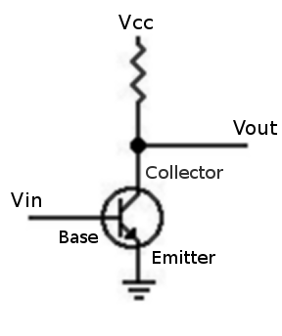
A Simple Transistor Inverter
Simple inverter circuit
If Vin is on, Vout will be off
Vin off, Vout on
A NOT gate
Input | Output
0 | 1
1 | 0

Slide 5
Transistors to Logic Gates
Using different circuits of transistors & resistors, a range of basic logic gates can be built up
Inverter is a NOT gate
  0 input becomes 1 output and vice versa
Other gates take two (or more) inputs
  E.g. AND gate produces 1 output only if both inputs are 1

Slide 6


_
Input A | Output A
0 | 1
1 | 0
NOT
AND
A | B | A∙B
0 | 0 | 0
0 | 1 | 0
1 | 0 | 0
1 | 1 | 1

Slide 7


A | B | A+B
0 | 0 | 0
0 | 1 | 1
1 | 0 | 1
1 | 1 | 1
OR
NOR
____
A | B | A+B
0 | 0 | 1
0 | 1 | 0
1 | 0 | 0
1 | 1 | 0

Slide 8


____
A | B | A∙B
0 | 0 | 1
0 | 1 | 1
1 | 0 | 1
1 | 1 | 0
NAND
XOR (Exclusive OR)
A | B | A⊕B
0 | 0 | 0
0 | 1 | 1
1 | 0 | 1
1 | 1 | 0

Slide 9
Building Blocks
Combine logic gates into larger circuits
Can use NAND or NOR gates as building blocks to build other logic gates, e.g.:
Simplifies construction of chips
What does this circuit do?
Can you build an OR gate from NAND gates?
A
Q
B

Slide 10
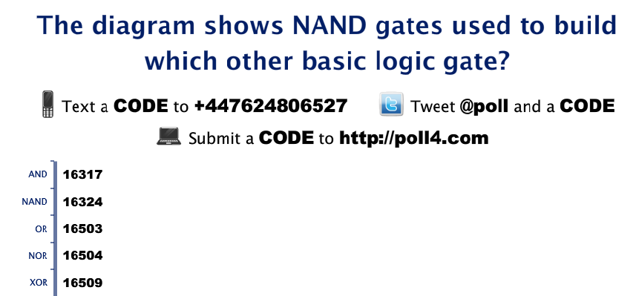
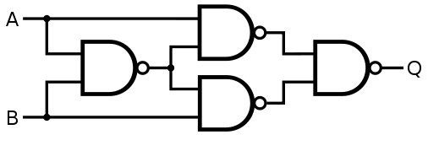
RESULTS

Slide 11
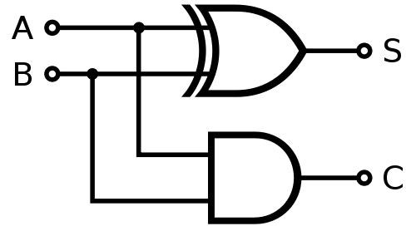
Half Adder
(Sum)
(Carry)
A | B | C | S
0 | 0 | 0 | 0
0 | 1 | 0 | 1
1 | 0 | 0 | 1
1 | 1 | 1 | 0

Slide 12
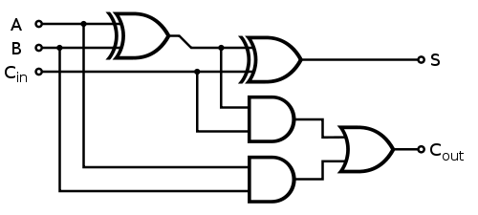
Full Adder
A | B
0 | 0
0 | 1
1 | 0
1 | 1
C_{in} | C_{out} | S
0 | 0 | 0
0 | 0 | 1
0 | 0 | 1
0 | 1 | 0
C_{in} | C_{out} | S
1 | 0 | 1
1 | 1 | 0
1 | 1 | 0
1 | 1 | 1

Slide 13
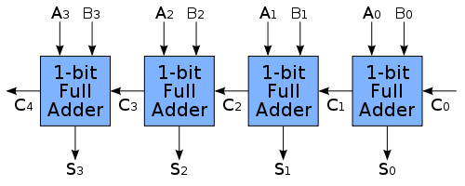
4 Bit Adder

Slide 14
Numbers: Basic Terms
Integers: The set of whole numbers, e.g.
... -3, -2, -1, 0, 1, 2, 3, ...
Real numbers: Numbers which may have a fractional element, e.g.
-3.2, 0.01, 3.14,...
  Repeating (recurring) numbers: Real number where the fractional element contains infinitely repeating digits, e.g. 1/3 = 0.33333...
Irrational Numbers: Numbers with infinitely long non-repeating sequences, eg PI
π = 3.1415926535897932384626433...

Slide 15
Unsigned Representations
Programming languages such as C or C++ allow developers to use unsigned integers
Positive only numbers
Range 0 to 2^{n}-1
  where n is the number of bits used to represent the number
  n typically equals 8 (byte), 16, 32 or 64
Negative numbers?

Slide 16
Sign and Magnitude
Simple approach: Use the first bit of any number to indicate whether it is positive or negative
First bit is sign (+ or -) bit, remainder is the magnitude (size) of the number
E.g. with 4 bits:
0011 = +3, 1011 = -3
0000 = +0, 1000 = -0
What is the range for 8 bit sign & magnitude?

Slide 17
Problems?
Simple arithmetic becomes complicated with sign & magnitude representations
E.g. one plus minus one:
1₁₀ + (-1₁₀)
0001 + 1001 = 1010 = -2₁₀
Two representations for zero
  0000 and 1000
  Extra logic required to test when two numbers are equal, in event both are zero

Slide 18
One’s Complement
Positive numbers start with zero
For negative number take the complement (opposite) of each bit
3 = 0011 so -3 = 1100
Using 4 bits, find the binary for +1₁₀ and -1₁₀
What is the result of adding these values?

Slide 19
One’s Complement
Still two values for zero: 0000 & 1111
But addition works as it should...
...almost. Need to carry and add back in if the result overflows:
 | Binary | Decimal
 | 1110 | -1
+ | 0010 | +2
1 | 0000 | 0 | Incorrect
 |  | +1 | Add carry
0 | 0001 | 1 | Correct!

Slide 20
Two’s Complement
Avoids having two representations for 0
Avoids having to carry extra bit & add back in
To get a negative number, invert all the bits then add 1:
  +3 = 0011
  Invert: 1100
  Add 1: 1101 = -3
Two’s Complement addition? +4 + -4

Slide 21
Two’s Complement
Only one zero: 0000
4bit:
Easy way to find the negative of a number:
0111 = 7 | 0000 = 0 | 1001 = -7 | 1000 = -8
 | Example 1 | Example 2
1. Starting from the right, find the first '1' | 0101001 | 0101100
2. Invert all of the bits to the left of that one | 1010111 | 1010100

Slide 22
Two’s Complement to Decimal
What is the decimal number represented by each of the following two’s complement binary numbers:
  11100111
  01100111
  10101010
  01010101
  00000000
  11111111

Slide 23
Two’s complement 11100111 to decimal
Leading 1, so a negative number
Negate to find the magnitude
Solution: -25
1. Starting from the right, find the first '1' | 11100111
2. Invert all of the bits to the left of that one | 00011001
3. Convert to decimal | 16 + 8 + 1 = 25

Slide 24
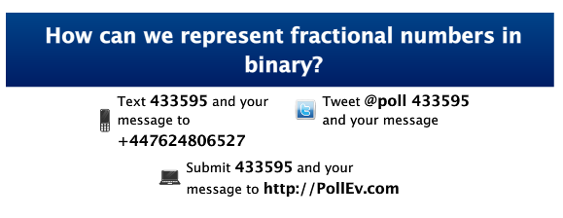
RESULTS

Slide 25
Fractions: Fixed Point Binary
Decimal point is set at fixed position
  E.g. With 16 bits, could have 12 bits then point then remaining 4 bits
Significance of digits after the point:
2⁻¹, 2⁻², 2⁻³... 2^{-n} ( 1/2, 1/4, 1/8, ... )
What are the largest and smallest values that can be stored in an unsigned 16 bit (12.4) representation?
2¹² = 4096, 2⁻⁴ = 1/2⁴ = 0.0625
Notes:
Note: largest number in unsigned 12.4 is actually 4096.9375 (2^12 + (1-0.0625) )

Slide 26
Fixed Point Challenge
Decimal | Binary
0.5 | 0.1
0.25 | 0.01
0.125 | 0.001
0.0625 | 0.0001
0.03125 | 0.00001
0.015625 | 0.000001
0.0078125 | 0.0000001
0.00390625 | 0.00000001
With 8 bits after the point, binary for:
0.75₁₀ =
0.3125₁₀=
0.1₁₀=
Notes:
Answers are: a) 0.11, b) 0.0101 and c) with 8 bits after the point, the closest we can get is 0.00011001² = 0.09765625 (0.0625 + 0.03125 + 0.00390625) –not all fractional numbers can be represented – sometime we have to approximate. Some numbers easily written in decimal cannot be represented with binary.

Slide 27
Floating Point Numbers
Fixed point representations place quite small limits on
  the size of the largest numbers that can be represented
  the size of the smallest fraction that can be represented
Floating point numbers allow computers to represent both very large and very small numbers
  but still have issues representing some numbers
Notes:
Might be an idea to take a break here... The next few slides get heavy going!

Slide 28
Decimal Floating Point Numbers
Can represent numbers using a floating point system, in decimal this might be:
  Significant digits are the mantissa or significand
  Multiplied by 10 to the power of some exponent
  here the exponents are 3 and -4
Number |  | Mantissa |  | Exponent
-293.87 | = | -0.29387 | x | 10³
0.0000983 | = | 0.983 | x | 10⁻⁴

Slide 29
IEEE 754: Floating Points
Standard binary representation
Take any real number – represent in three parts:
  Sign: The first bit is 0 (positive) or 1 (negative)
  Exponent: The next n many bits
  Mantissa: The remaining m bits represent the significant digits of the number
Most commonly uses 16, 32 or 64 bits
  Limited number of bits can represent large range

Slide 30
32 bit IEEE Floating Point
A float variable in C/C++
8 bit exponent is unsigned, but has bias value added – to give a range of -127...+128
  Allows for very small or very large numbers
Sign | Exponent | Mantissa | Bias | Precision
1 bit | 8 bits | 23 bits | 127 | 24 bit

Slide 31
Special Values
The IEEE 754 standard specifies some special values:
  +0 and -0
  Infinities (e.g. 1/0)
  NaN (Not a Number) – some invalid operations such as 0/0 result in NaN
  Infinity or NaN results can crash programs that are not prepared to handle such results
Notes:
Depending on timing, this is also a good point to take a break... Next slide is the start of the section on logic

Slide 32
Further Reading
See Module References section on Blackboard
  Lots of links
PCH, 2.1 – 2.3, 4.1 – 4.3, 4.7 – 4.10
  Remainder of Chapters 2 & 4 for interest only

Slide 33
Next Week
Required Reading
HCW Part 3
  Overview (p82-93)
  Chapter 7 (p94-103)
Additional Reading
  ECS Chapters 6 & 10

Slide 34
This work by Daniel Livingstone at the University of the West of Scotland is licensed under the Creative Commons Attribution-ShareAlike 3.0 Unported License. To view a copy of this license, visit http://creativecommons.org/licenses/by-sa/3.0/ or send a letter to Creative Commons, 171 Second Street, Suite 300, San Francisco, California, 94105, USA.
Image Credits:
Title Image and Transistor Inverter circuit CC-BY-SA Daniel Livingstone, 2011 (Inverter circuit drawn using Klunky)
Logic Gates, Half Adder and Full Adder circuits all public domain images, sourced from Wikipedia and Wikimedia Commons
4 Bit Adder, CC-BY-SA en:User:Cburnett, http://en.wikipedia.org/wiki/File:4-bit_ripple_carry_adder.svg
Product names, logos, brands, and other trademarks featured or referred to within the these notes are the property of their respective trademark holders. These notes have been produced without affiliation, sponsorship or endorsement from the trademark holders.

